Slide 1

Nanopore sequencing to reveal the origins of circulating immune DNA in cancer
Ben Berman, PhD
Principal Bioinformatician, Volition
Associate Professor, Hebrew University of Jerusalem
Disclosures
- Full-time paid consultant for Volition
- Project funded by Volition
Notes:
I won’t show everything here because I only have a 10 minute talk
Currently I have 20 slides so I need to reduce significantly.
It would be helpful if you keep track of which parts are less important and can be dropped.
---
This project was completely funded by Volition

Slide 2
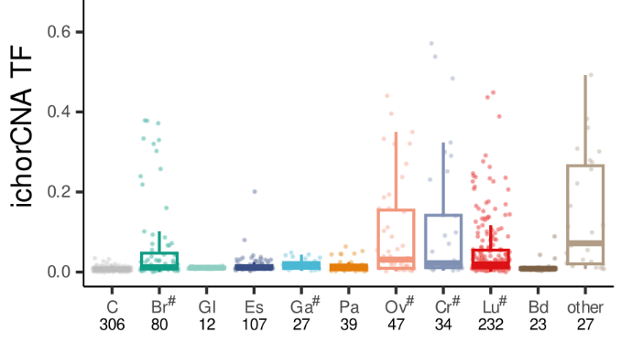
Background - Elevated immune cfDNA in cancer
In cancer patients, fraction of cancer-derived circulating DNA rarely goes above 50%
ichorCNA Tumor Fraction
(Illumina WGS, ichorCNA to analyze copy number alterations)
Moldovan et al., 2024, Cell Reports Medicine 5, 101349 January 16, 2024
Multi-modal cell-free DNA genomic and fragmentomic patterns enhance cancer survival and recurrence analysis
https://doi.org/10.1016/j.xcrm.2023.101349
Notes:
This is from a recent large recent sequencing study which used copy number analysis to determine circulating tumor DNA as a fraction of total DNA.
It rately goes above 50%

Slide 3
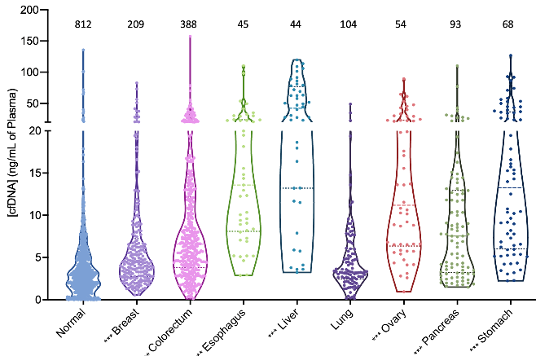
Background - Elevated immune cfDNA in cancer
In cancer patients, fraction of cancer-derived circulating DNA rarely goes above 50%
However, total cfDNA levels are often 10x higher than healthy individuals
Thus, non-cancer DNA must be highly elevated as well
Total DNA ng/mL
80x Illumina Whole-Genome Bisulfite (WGBS)
Mattox AK,et al. The Origin of Highly Elevated Cell-Free DNA in Healthy Individuals and Patients with Pancreatic, Colorectal, Lung, or Ovarian Cancer. Cancer Discov. 2023 Oct 5;13(10):2166-2179.
10.1158/2159-8290.CD-21-1252
Notes:
When you measure the fraction of total cfDNA in cancer, is often 10x higher than healthy individuals of similar age.
So even if 50% of cfDNA in cancer is immune-derived, it is very highly elevated relative to healthy

Slide 4
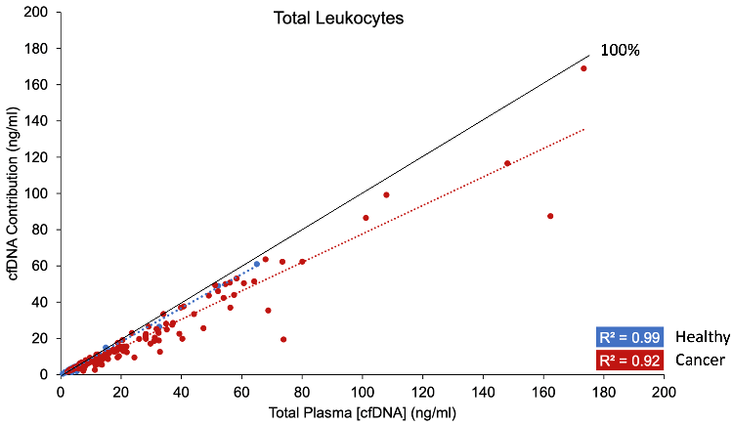
Background - Elevated immune cfDNA in cancer
In cancer patients, fraction of cancer-derived circulating DNA rarely goes above 50%
However, total cfDNA levels are often 10x higher than healthy individuals
Thus, non-cancer DNA must be highly elevated as well
Non-cancer DNA is primarily immune cell types
Leukocyte contribution ng/mL
Total DNA ng/mL
80x Illumina Whole-Genome Bisulfite (WGBS)
Methylation-based Cell of Origin (COO) analysis
Mattox AK,et al. The Origin of Highly Elevated Cell-Free DNA in Healthy Individuals and Patients with Pancreatic, Colorectal, Lung, or Ovarian Cancer. Cancer Discov. 2023 Oct 5;13(10):2166-2179.
10.1158/2159-8290.CD-21-1252
Notes:
This study from Johns Hopkins used DNA methylation to determine the contribution of different cell types to total DNA
Leukocytes almost generally contributed 50% or more, in agreement with copy number analysis

Slide 5
Background - Elevated immune cfDNA in cancer
Questions:
Can PCR-free Nanopore sequencing provide a better view on cancer fragmentomes?
Can methylation from Nanopore sequencing be used for COO analysis?
Leukocyte contribution ng/mL
Total DNA ng/mL
80x Illumina Whole-Genome Bisulfite (WGBS)
Methylation-based Cell of Origin (COO) analysis
Mattox AK,et al. The Origin of Highly Elevated Cell-Free DNA in Healthy Individuals and Patients with Pancreatic, Colorectal, Lung, or Ovarian Cancer. Cancer Discov. 2023 Oct 5;13(10):2166-2179.
10.1158/2159-8290.CD-21-1252
Notes:
We want to develop Nanopore methylation sequencing as a mehthod to understand this better.

Slide 6
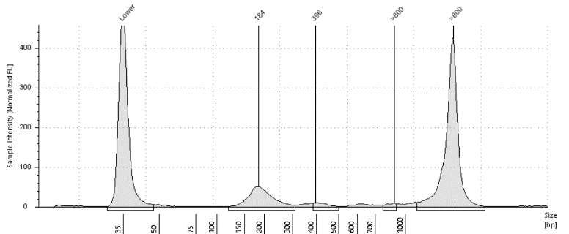
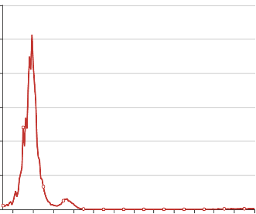
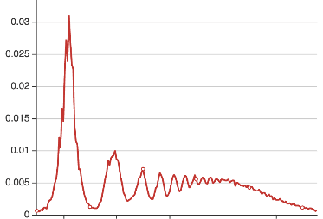

Example of paired Illumina / ONT sequencing
Lung cancer CB-58 TapeStation (% DNA)
Stage IV-A Non-Small Cell Lung Cancer
Age: 43 years
78.5%
>800 bp
Longer ONT reads described in:
Yu SCY, Choy LYL, Lo YMD. 'Longing' for the Next Generation of Liquid Biopsy:
The Diagnostic Potential of Long Cell-Free DNA in Oncology and Prenatal Testing.
Mol Diagn Ther. 2023 Sep;27(5):563-571.
https://doi.org/10.1007/s40291-023-00661-2
Ymke van der Pol, et al.
Real‐time analysis of the cancer genome and fragmentome from plasma and
urine cell‐free DNA using nanopore sequencing.
EMBO Mol Med (2023)15: e17282
https://doi.org/10.15252/emmm.202217282
CB-58 Illumina WGS
CB-58 ONT WGS
0%
>800bp
43%
>800 bp
Proportion of DNA
Proportion of DNA
Frag len (log scale)
Frag len (log scale)
Notes:
Here is a motivating example.
This lung cancer patient had a tapestation showing a large amount of DNA greater than 800bp
We sequenced in Illumina and ONT, and you can see the dramatic difference
notice I am using log scale on both

Slide 7
Oxford Nanopore Sequencing study –
Two questions to address:
Can PCR-free Nanopore sequencing provide a better view on cancer fragmentomes?
Can methylation from Nanopore sequencing be used for COO analysis?
Oxford Nanopore Technologies (ONT) study (1-5 mL plasma)
  37 stage III/IV cancer cases from 12 cancer types
  21 healthy plasmas
  Native ONT sequencing (no PCR): 1-10M reads (R9.4.1/lsk114)
  Matched Illumina sequencing: 10-20M reads
  Total DNA (Qubit), Total H3.1 nucleosomes (Nu.Q® i10-based ELISA)
Notes:
In order to answer these questions, we began a small ONT sequencing study with multiple cancer types
Importantly, we incorporate two different measures of total DNA and chromatin concentration

Slide 8


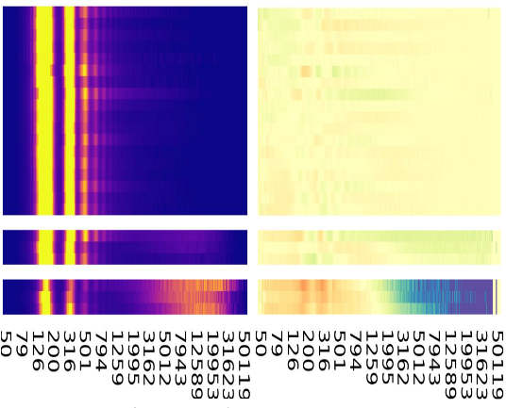
3 healthy plasmas with ultra-long fragments
Counts
(normalized)
Healthy
n=18
Healthy ultra-long frags
n=3
E2
E2
Frag length (log scale)
Frag length (log scale)
Notes:
First we looked at fragment length in the healthys. We have 3 samples which had very long fragments
They are more visible if I normalize each column
[ANIMATION]

Slide 9

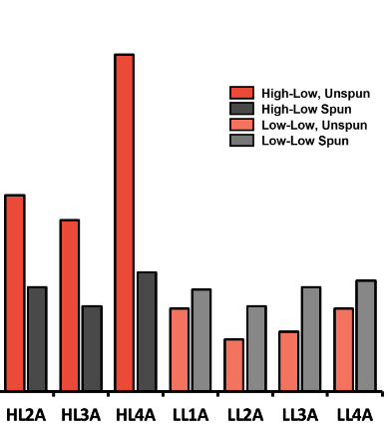

Hypothesis – Ultra-long fragments derive from genomic DNA of cells lysed during thawing
-80 freezer
Spun
(normal protocol)
Unspun
Qubit DNA concentration
E2
thaw
RT<2hours
thaw
RT<2hours
Unspun
Spun
Qubit
14,000 x g
2 minutes
Nu.Q® H3.1
ONT
Qubit
ONT
Nu.Q® H3.1
Healthies w/
Ultralong fragments
Other Healthies
Notes:
Our normal protocol includes a high speed spin to remove genomic DNA from lysed cells,
In order to investigate these further, we looked at unspun aliquots of the same samples
[Animation]
Unspun protocol shown here. When we look at total DNA levels….
[Animation]
While the spun samples are not significantly elevated in total DNA concentration,
The Unspun samples were
When we went on to sequence these..
[Add graphic?]

Slide 10
Length distribution of ultra-long fragments is consistent in spun and unspun samples
Counts
(normalized)
Healthy
n=18
Healthy ultra-long frags (n=3)
4-9% of DNA > 7.5kb
Healthy ultra-long frags, unspun
38-48% of DNA > 7.5kb
Frag length (log scale)
Frag length (log scale)
Notes:
You can see that these clearly show up around

Slide 11

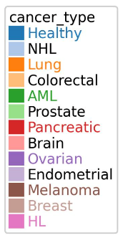
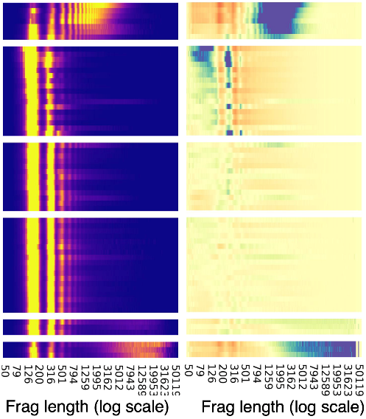

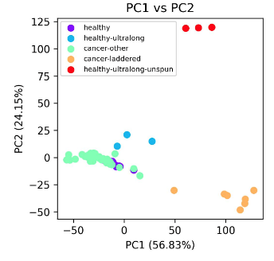
Combined fragment length clustering of Healthy and cancer samples (PCA)
Counts
(normalized)
PC1
PC2
Cancer signature PC1
(5 AML, 1 Lung, 1 NHL)
Cancer other
(n=30)
UL Unspun
UL Spun
laddered
Healthy typical
(n=18)
Healthy ultra-long (n=3)
Healthy ultra-long unspun (n=3)
Notes:
We next perfomed an unsupervised clustering of healthy and cancer samples based on fragment length.
You can see the healthy samples as before
We now add the cancer samples, and the 1st two principal component definitions
[Animation]
You can see that both capture reads longer than 1kb
PC2 primarily captures the ultra-long reads in the healthies
PC1 is a shorted length range, from 900bp-4000bp, and defines the 7 cancers in this top group
4 are Acute Myeloid Leukemia, 1 is Non-hodgkins lymphoma, and 1 is non-small cell lung cancer
I am also showing the other 30 cancers , which I will get back to in a moment.
[Animation]
You can see that these first two components cluster the ultra-long spun and unspun , away from the laddered cancers. All the other cancers and healthies are together here

Slide 12
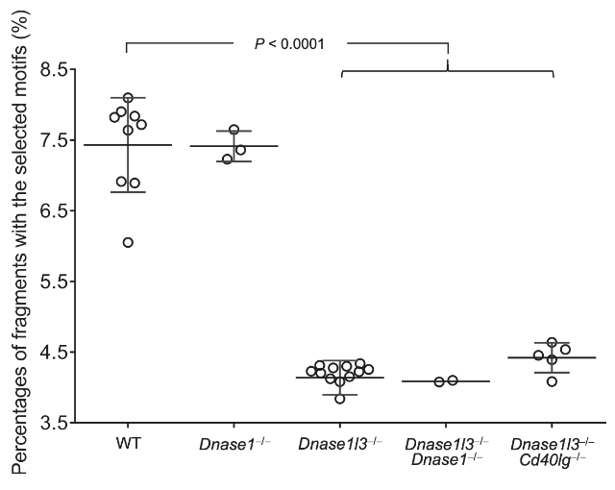
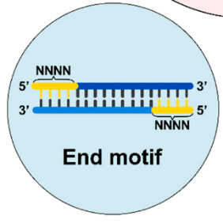
DNASE1L3 end motif signature
High CC end motif frequencies in plasma are DNASE1L3-dependent
Serpas et al., Dnase1l3 deletion causes aberrations in length and end-motif frequencies in plasma DNA. Proc. Natl. Acad. Sci. USA 2019, 116, 641–649.
https://doi.org/10.1073/pnas.1815031116
Han DSC et al., The Biology of Cell-free DNA Fragmentation and the Roles of DNASE1, DNASE1L3, and DFFB. Am J Hum Genet. 2020 Feb 6;106(2):202-214.
10.1016/j.ajhg.2020.01.008
Chan RWY et al., Plasma DNA Profile Associated with DNASE1L3 Gene Mutations: Clinical Observations, Relationships to Nuclease Substrate Preference, and In Vivo Correction.
Am J Hum Genet. 2020 Nov 5;107(5):882-894.
10.1016/j.ajhg.2020.09.006
Ding, S.C.; Lo, Y.M.D. Cell-Free DNA Fragmentomics in Liquid Biopsy. Diagnostics 2022, 12, 978. https://doi.org/10.3390/diagnostics12040978
DNASE1L3 Activity occurs in circulation
Notes:
We know that fragmentation patterns are determined by cellular and circulating DNAses
Dennis Lo’s lab and others have defined end motifs that define
DNASE3L1 activity, which occurs in circulation
So we can plot CC end motif frequency in these different fragment lengths…

Slide 13
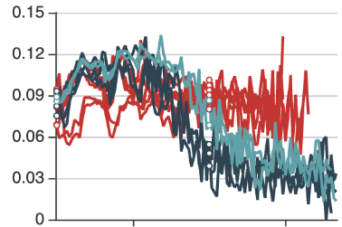

PC1-high long fragments exhibit DNASE1L3 CC end motif signautre; PC2-high fragments do not
PC1
PC2
Cancer signature PC1
(n=7)
Cancer PC1-high samples
Cancer other
(n=30)
CC end motif frac
CC end motif fraction
genomic
bg
Healthy typical
(n=18)
Frag length (log scale)
Healthy ultra-long (n=3)
Healthy ultra-long PC2-high
Counts
(normalized)
Healthy ultra-long unspun (n=3)
Healthy ultra-long (unspun) PC2-high
Notes:
What I am plotting here is CC end motif frequency as a function of fragment length
What you can see is that all these groups of samples have elevated CC motif signature in fragments <600bp
But in the longer fragments, the PC1-high cancer samples still have elevated CC motifs, whereas the healthy ultra-long fragments return to the genomic background
This is consistent with the ultra-long fragments deriving from genomic DNA from lysed cells, while the cancer long fragments are fragmented in vivo

Slide 14
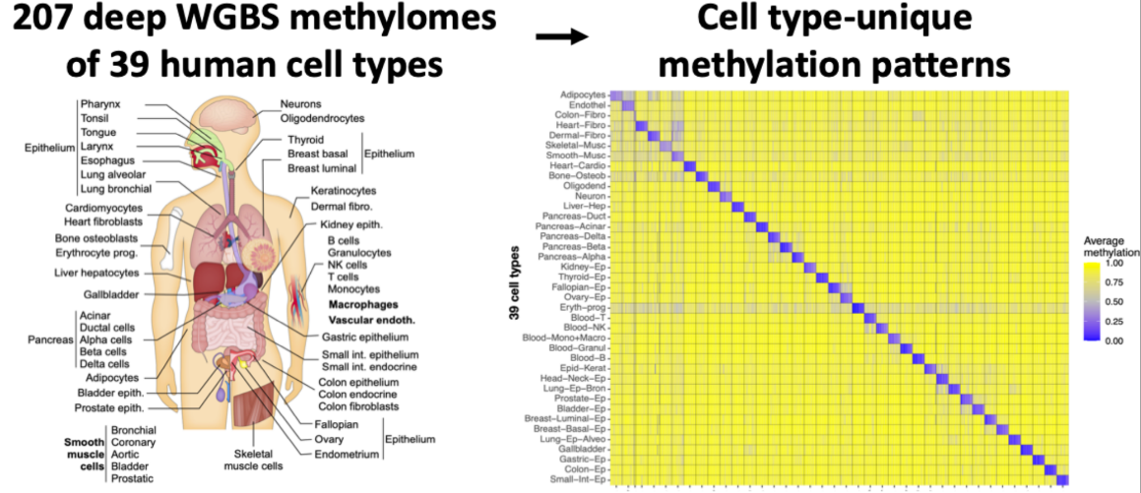
Methylation Cell of Origin (COO) of long fragments
Loyfer, N., et al. A DNA methylation atlas of normal human cell types. Nature 613, 355–364 (2023). https://doi.org/10.1038/s41586-022-05580-6
Multi-cell type deconvolution using a probabilistic model for single-molecule DNA methylation haplotypes. Unterman, I., et al bioRxiv 2023.08.20.554012
https://doi.org/10.1101/2023.08.20.554012
Notes:
We can use the methylation information in these long reads to hopefully understand where these come from
We use a whole-genome methylation atlas developed by Tommy Kaplan and Yuval Dor’s labs
Our sequencing coverage here is quite limiting, and these results are very preliminary. We are working on sequencing more samples at greater depth for better resolution

Slide 15
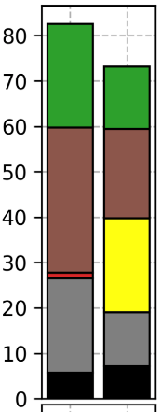
Methylation Cell of Origin (COO) of long fragments
Lung cancer CB-58
Example: PC1-high lung cancer (CB-58)
PC1-associated long fragments:
  Majority contribution is immune origin
  Decrease in cancer cell of origin (Epithelial)
  Possible increase in T-cell fraction
Preliminary: requires additional samples and deeper sequencing
Epithelial
Monocytes+Macrophages
Percent cell of origin
T-cells
Granulocytes
NK-cells
Eryth progenitors
Typical frags
(100-400bp)
PC1 long frags
(900-4,300bp)
Notes:
The lung sample I showed you earlier is the only non-hematopoetic cancer among the 7 with laddered reads.
We compare typical length fragments to the PC1 900-4000 bp fragments
As you can see, the majority if the contribution is still from immune cells, with a slight decrease in cancer cells.
There may be a shift from myeloid to lymphoid cell type, but I consider this very prelinary and not reliable yet
blood_columns = pd.Series(['Eryth-prog','Blood-Granul','Blood-NK','Blood-B', 'Blood-T', 'Blood-Mono+Macro','Epithelial']) # 'Lung-Ep'])
my_colors = ['black','tab:gray','tab:red','tab:orange','yellow','tab:brown','tab:green']

Slide 16
PC3 is defined by shortened cfDNA in cancer
Cancer signature PC1
(n=7)
Ordered and grouped by Principal Component 3
Cancer other
(n=30)
Healthy typical
(n=18)
Healthy ultra-long (n=3)
Counts
(normalized)
Healthy ultra-long unspun (n=3)
Notes:
Next I want to shift back to the remainging cancers
You remember that the first 2 Principal components defined the long fragment cancers.
The remaining cancers are grouped by the 3rd principal component.

Slide 17
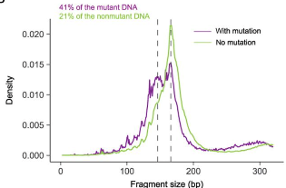

PC3 is defined by shortened cfDNA in cancer
Cancer signature PC1
(n=7)
PC3
PC3-high cancers
(n=17)
Jiang P,et al. Lengthening and shortening of plasma DNA in hepatocellular carcinoma patients. Proc Natl Acad Sci U S A. 2015 Mar 17;112(11):E1317-25.
https://doi.org/10.1073/pnas.1500076112
Mouliere F. et al, Enhanced detection of circulating tumor DNA by fragment size analysis. Sci Transl Med. 2018 Nov 7;10(466):eaat4921.
10.1126/scitranslmed.aat4921
Katsman, E., et al. Detecting cell-of-origin and cancer-specific methylation features of cell-free DNA from Nanopore sequencing. Genome Biol 23, 158 (2022). https://doi.org/10.1186/s13059-022-02710-1
Cancer other
(n=30)
PC3-low
cancers
(n=13)
Healthy typical
(n=18)
Healthy ultra-long (n=3)
Counts
(normalized)
Healthy ultra-long unspun (n=3)
Notes:
If we look at the definition of PC3, you can see it is defined by increased numbers of fragments
In blue, you can see these increases:
Shorter than the typical mononucleosome (65-145). POINT IT OUT
And between the size of the typical mono and di-nucleosomes (245-295)
Importantly, you can see in red the sizes that are depleted.
The typical mononucleosome and dinucleosome,
But also trinucleosomes and in fact all fragment lengths up to 2-3kb
[animation]
This phenomenon of short mono. And di-nucleosomes has been described before.
Interestingly, these shorter fragments are sometimes enriched for cancer DNA.

Slide 18
How does fragment shortening (PC3) relate to other features:
Evidence for high cancer DNA
  Detection of Copy Number Alterations
  Detection of Methylation Cell of Origin (COO)
Evidence of DNASE1L3 activity (CC end motifs)
Elevated concentration of total cfDNA and immune cfDNA
Notes:
We wanted to investigate the relationship between this shortening feature, as measured by the PC3 value
We can calculate a number of features for each sample
Copy number alterations and detection of cancer cell of origin indicate a high level of cancer DNA
CC end motifs indicate DNASE1L3 activity
And we can use our total DNA and H3.1 nucleosome measurements to look at total DNA

Slide 19
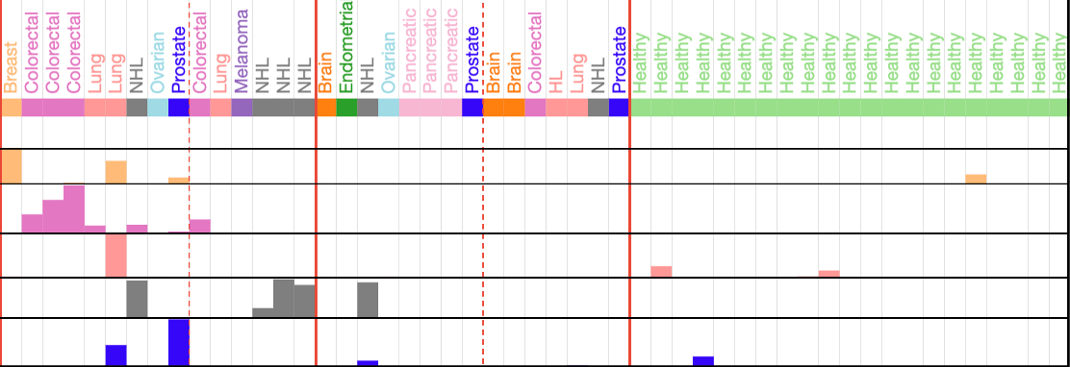
Detection of CNA and cancer Cell of Origin converge on the same cases, irrespective of PC3 status
CNA (15)
No CNA (15)
PC3-high (9)
PC3-low (6)
PC3-high (8)
PC3-low (7)
Healthies (21)
Cancer type
Breast COO (z-score)
G.I. COO (z-score)
Lung COO (z-score)
B-cell COO (z-score)
Prostate COO (z-score)
Correct cell of origin
*
*
*
*
*
*
*
*
*
*
*
*
Notes:
I summarize here CNA and Cancer Cell of Origin results for the 30 cancers
We detect the correct cell of origin for 5 of the 11 cancer types.
You can see that almost all of these occur in samples where we also detect copy number alterations
We use these data , combined with the other features, to perform a global correaltion analysis across these 30 samples

Slide 20


DNASE1L3-associated fragmentation features are more strongly associated with total DNA levels than cancer DNA levels
High cancer DNA
PC3 shortening
DNASE1L3 activity
Elevated
Total cfDNA
Nu.Q®
Nu.Q®
Spearman’s rho
rho=-0.68
Notes:
We see a number of interesting things here
The CAN and cell of origin form a cluster as I just showed
The PC3 fragment shortening fratures and the CC end motif signature cluster. Both of these features have been linked to DNASE1L3, so this is not unexpected.
Potentially the most interesting aspect is that they PC3 shortening is modertately correlated with the Elevated total DNA measurements
YOU CAN SEE THAT HERE ->
We find this interesting that DNASE1L3-associated fragmentation features are more strongly associated with total DNA levels than cancer DNA levels
While this is only correlation based on a relatively small number of samples, our conclusion is that the shortening of DNA and the elevated levels of immune DNA could be mechanistically linked
If this were true , it means that immune cell DNA must be fragmented into these short fragments along with cancer DNA

Slide 21
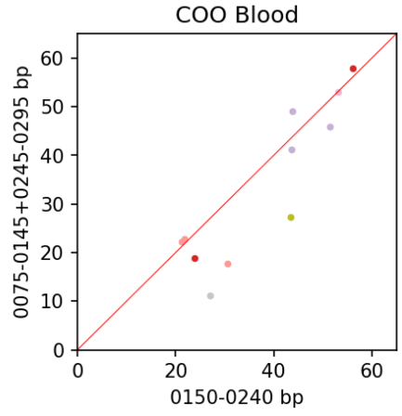
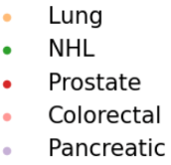


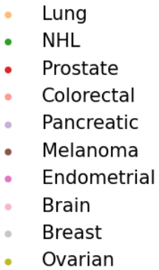
PC3-defined short fragments have similar immune:cancer ratio as typical fragments
COO analysis for:
11 samples with high number of PC-3 shortened fragments
AML ommitted
Blood fraction sometimes has moderate reduction in short fragments
Percent Blood Cell Types
PC3 short frags
(75-145bp, 245-295bp)
Percent Blood Cell Types
Typical frags
(100-400bp)
Notes:
We looked at this by doing Cell of Origin analysis for blood cell types.
In the typical length fragments vs. the PC3 shorter fragments.
What you can see is that the Blood fragment sometimes has a moderate reduction in the short fragments, but only moderate.
Our data based on cancer DNA detection agrees with this.

Slide 22
Conclusions and future directions
ONT plasma sequencing identifies multiple distinct classes of long cfDNA fragments
  1-4kb fragments have in vivo fragmentation signature and tend to occur in hematopoetic cancers
  Can distinguish these from contamination of genomic DNA that occurs during processing
Elevated levels of immune DNA could be mechanistically linked to shortened fragmentation sizes
  Impaired cfDNA clearance and/or circulating DNASE1L3 availability?
Newer ONT reagents is yielding improved Cell of Origin analysis
  This study used MinION R9: 1-10M reads per flowcell (1 sample)
  Current work uses PromethION P2 Solo R10: 120M reads per flowcell (4-6 samples)
Notes:
To summarize,
ONT plasma sequencing identifies interesting long fragment cancer phenotypes, and can distinguish these fragments from genomic contamination that occurs during processing.
Second, we find evidence that elevated levels of immune DNA could be mechanistically linked to shortened fragment sizes, which we might speculate could be related to cfDNA clearance or DNASE1L3 availability
Finally, this work was based on much significantly lower read numbers than we can achieve currently

Slide 23
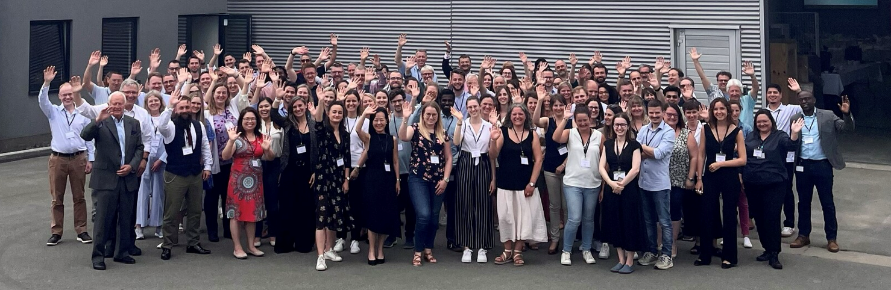
Acknowledgements
Volition:
Sarah Erdman, Justin Cayford, Terry Kelly
Marielle Herzog & Priscilla Van den Ackerveken (see posters!), Daniel Halter, Jacques Avaux,
Gaetan Michel

